Slide 1



Artificial Intelligence Chapter 10 Planning, Acting, and Learning

Slide 2




Contents
The Sense/Plan/Act Cycle
Approximate Search(逼近搜索)
Learning Heuristic Functions
Rewards Instead of Goals（奖赏代替目标）

Slide 3
How to use our search methods in realistic settings?
assumptions we made are often not met
→ need agent architectures tolerating violations to our assumptions
search spaces are too large
→ need modifications of search methods to address time & space limitations
we do not know the correct ’h-functions’
→ learning of heuristic functions
we do no know the effects of our actions
→ learning of action models

Slide 4
The Sense/Plan/Act Cycle
Pitfalls on idealized assumptions in Chap. 7
Perceptual processes might not always provide the necessary information about the state of the environment
e.g.) perceptual aliasing
Actions might not always have their modeled effects
There may be other physical processes in the world or other agents
The existence of external effects causes another problem

Slide 5
The Sense/Plan/Act Cycle
The agent might be required to act before it can complete a search to a goal state
Even if the agent had sufficient time, its computational memory resources might not permit search to a goal state.
Approaches for above difficulties
probabilistic methods
MDP [Puterman, 1994], POMDP [Lovejoy, 1991]
sense/plan/act with environmental feedback
working around with various additional assumptions and approximations

Slide 6
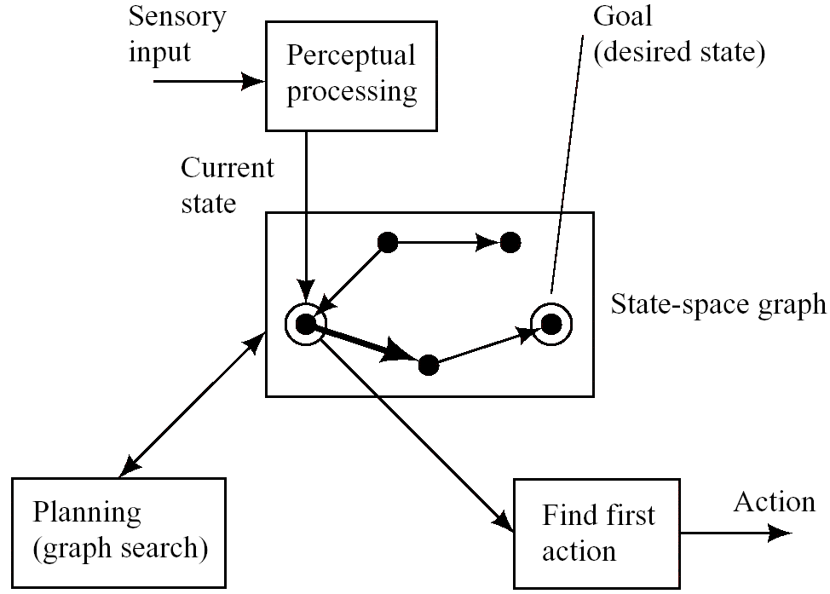
Figure 10.1: An Architecture for a Sense/Plan/Act Agent

Slide 7
Approximate Search
Definition
Search process that address the problem of limited computational and/or time resources at the price of producing plans that might be sub-optimal or that might not always reliably lead to a goal state.
Relaxing the requirement of producing optimal plans reduces the computational cost of finding a plan.
Search for a complete path to a goal node without requiring that it be optimal.
Search for a partial path that does not take us all the way to a goal node
e.g.) A*-type search, anytime algorithm [Dean & Boddy 1988, Horvitz 1997]

Slide 8
Approximate Search
Island-Driven Search
establish a sequence of “island nodes” in the search space through which it is suspected that good paths pass.
Hierarchical Search
much like island-driven search except that it do not have an explicit set of islands.

Slide 9
Approximate Search
Limited-Horizon Search
It may be useful to use the amount of time or computation available to find a path to a node thought to be on a good path to the goal even if that node is not a goal node itself
n*: a node having the smallest value of f’ among the nodes on the search frontier when search must be terminated.
σ(n₀, a): the description of the state the agent expects to reach by taking action a at node n₀.

Slide 10
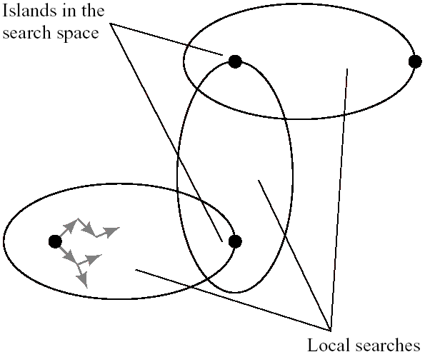
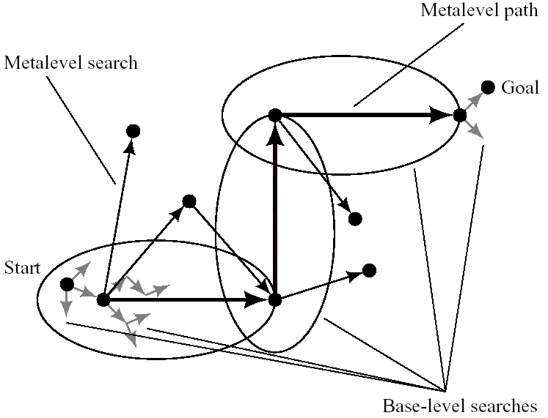
Figure 10.2: An Island-Driven Search
Figure 10.3: A Hierarchical Search

Slide 11
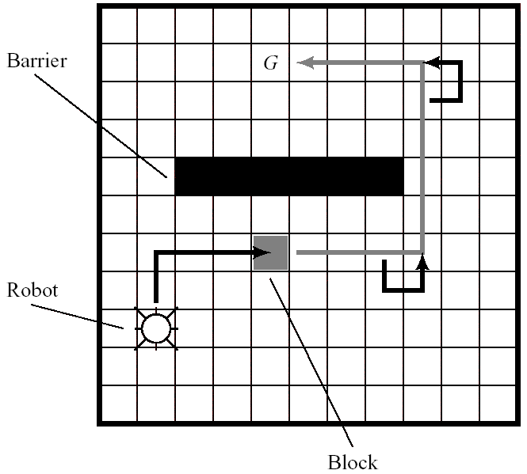
Figure 10.4: Pushing a Block

Slide 12
Approximate Search
Cycles
An agent may return to a previously visited environmental state and repeat the action it took there
Real-time A* (RTA*): build an explicit graph of all states actually visited and adjusts the h’ values of the nodes in this graph in a way that biases against taking actions leading to states previously visited.
Building reactive procedures
Reactive agents can usually act more quickly than can planning agents.

Slide 13
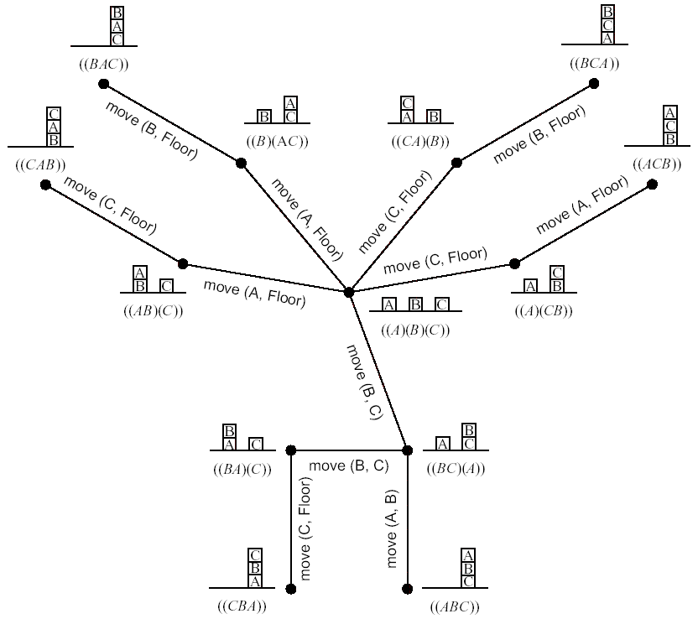
Figure 10.5: A Spanning Tree for a Block-Stacking Problem

Slide 14
Learning Heuristic Functions
Learning from experiences
Continuous feedback from the environment is one way to reduce uncertainties and to compensate for an agent’s lack of knowledge about the effects of its actions.
Useful information can be extracted from the experience of interacting the environments.
Explicit Graphs and Implicit Graphs

Slide 15
Learning Heuristic Functions
Explicit Graphs
Agent has a good model of the effects of its actions and knows the costs of moving from any node to its successor nodes.
C(n_{i}, n_{j}): the cost of moving from n_{i} to n_{j}.
σ(n₀, a): the description of the state reached from node n after taking action a.
DYNA [Sutton 1990]：Combination of “learning in the world” with “learning and planning in the model”.

Slide 16
Learning Heuristic Functions
Implicit Graphs
Impractical to make an explicit graph or table of all the nodes and their transitions.
To learn the heuristic function while performing a search process.
e.g.) Eight-puzzle
W(n): the number of tiles in the wrong place, P(n): the sum of the distances that each tile if from “home”

Slide 17
Learning Heuristic Functions
Learning the weights
Minimizing the sum of the squared errors between the training samples and the h’ function given by the weighted combination.
Node expansion
Temporal difference learning [Sutton 1988]: the weight adjustment depends only on two temporally adjacent values of a function.

Slide 18
Rewards Instead of Goals
State-space search
More theoretical condition
It is assumed that the agent had a single, short-term task that could be described by a goal condition.
Practical problem
The task cannot be so simply stated.
The user expresses his or her satisfaction and dissatisfaction with task performance by giving the agent positive and negative rewards.
The task for the agent can be formalized to maximize the amount of reward it receives.

Slide 19
Rewards Instead of Goals
Seeking an action policy that maximizes reward
Policy Improvement by Its Iteration
π: policy function on nodes whose value is the action prescribed by that policy at that node.
r(n_{i}, a): the reward received by the agent when it takes an action a at n_{i}.
ρ(n_{j}): the value of any special reward given for reaching node n_{j}.

Slide 20
Value iteration
[Barto, Bradtke, and Singh, 1995]
Delayed-reinforcement learning
learning action policies in settings in which rewards depend on a sequence of earlier actions
temporal credit assignment
credit those state-action pairs most responsible for the reward
structural credit assignment
in state space too large for us to store the entire graph, we must aggregate states with similar V’ values.
[Kaelbling, Littman, and Moore, 1996]

Slide 21
Discussion
Discussion
Interleaved planning
actions work as modeled most of the time
Improviation
actions work not as modeled most of the time
bad agent design?
L.H.S.: Where to put the horizon?
depends on
value of the action already found
value of (the result obtained by) additional computation (which we don’t know)
cost of delay in acting
decision is an instance of metalevel computation
appraising the relative values of more computation & immediate action

